Slide 1
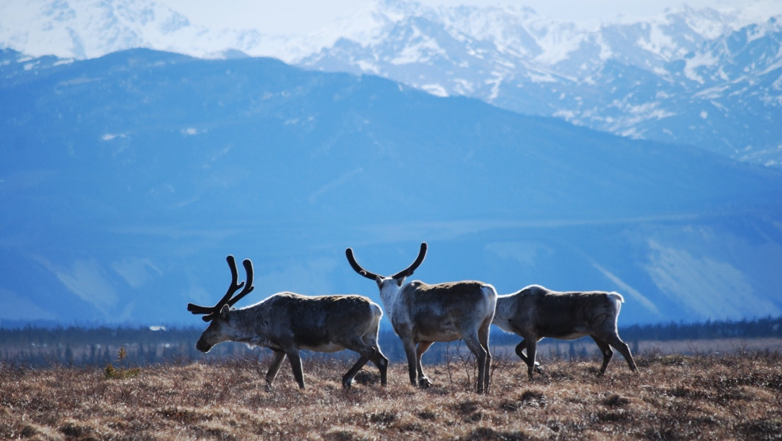
Arctic Boreal Vulnerability Experiment (ABoVE)
2019 ABoVE Airborne Flights
1 July 2019 (DOY 182)
AVIRIS-NG: Transit Bellingham WA – Fairbanks
Kluane Lake
Charles Miller, Deputy Science Lead
Jet Propulsion Laboratory, California Institute of Technology
and the ABoVE Science Team For Hank Margolis, Mike Falkowski, Bruce Tagg, Jack Kaye
NASA HQ
2019

Slide 2
1 July 2019/DOY 182 Bellingham WA - Fairbanks Transit; Kluane Lake YT
Daily Status:
AVIRIS-NG / Dynamic Aviation B-200 (N53W)
REPORT DATE: 1 July 2019
Current Status of Aircraft: GREEN
Current Status of AVIRIS: GREEN
Current Deployment Location: Fairbanks AK (PAFA)
Crew: S Wilson (PIC), C McCann, M Eastwood, L Rios
Science Planning: A Thorpe
Data Processing: W Olsen-Duvall
Instrument Manager: M Eastwood
Instrument PI: R Green
Science Lead: C Miller

Slide 3
1 July 2019/DOY 182 Bellingham WA - Fairbanks Transit; Kluane Lake YT
Daily Summary:
Leg 1: Transit Bellingham WA – Juneau AK
Leg 2: Juneau AK – Kluane Lake YT - Fairbanks
Took advantage of relatively clear skies during overflight of Kluane Lake region to acquire lines there (Lines Bxx-yy)
Acquired Big Trail Lake (Line Bxx) line near Fairbanks to exploit relatively smoke-free skies
Team arrives in Fairbanks to begin Alaska Part 1 (1 – 12 July)

Slide 4
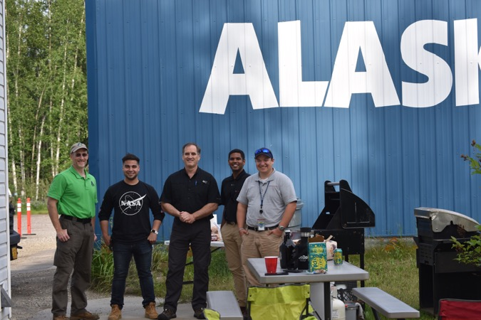
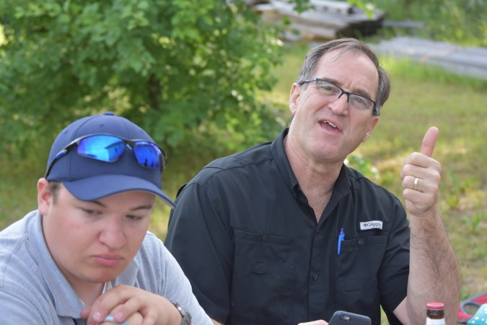
Canada Day BBQ

Slide 5
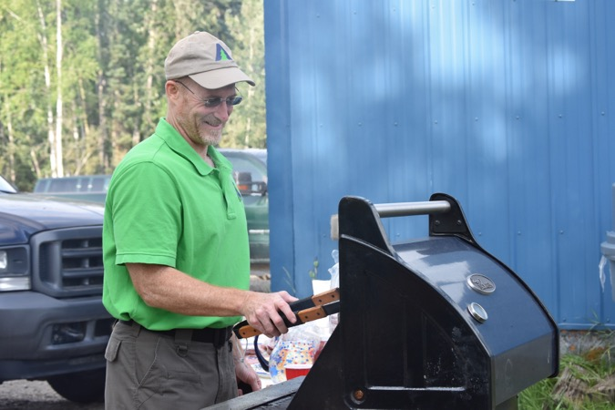
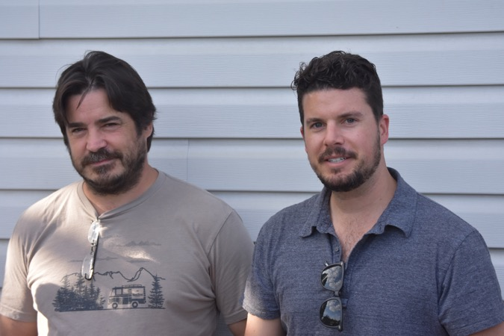
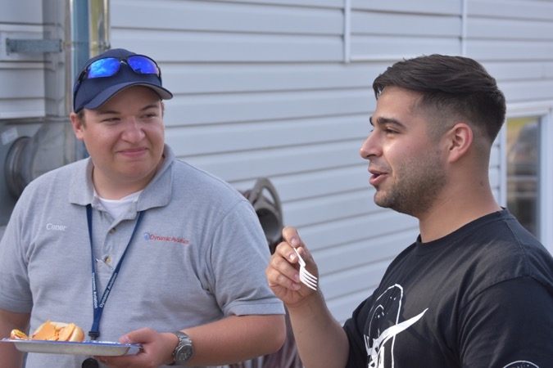
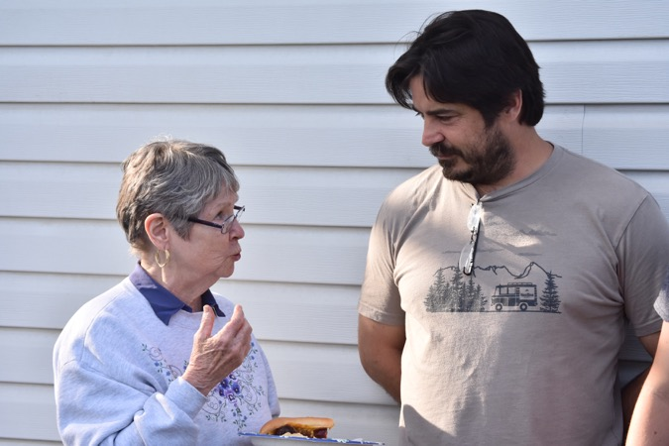
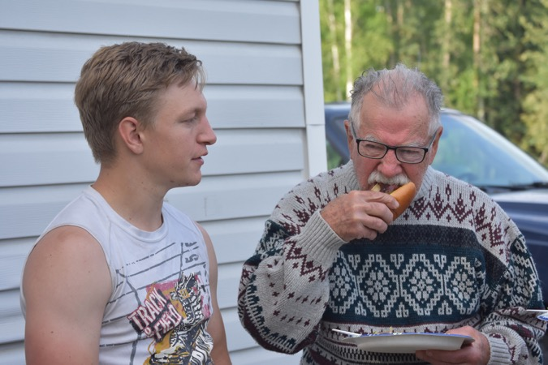
Canada Day BBQ

Slide 6
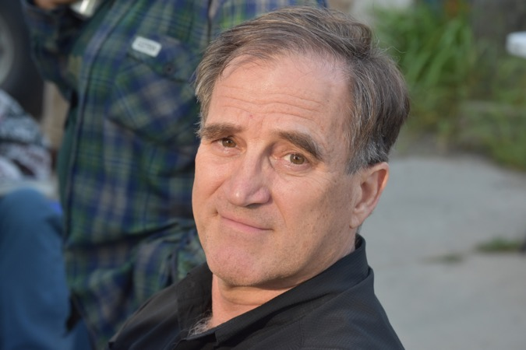
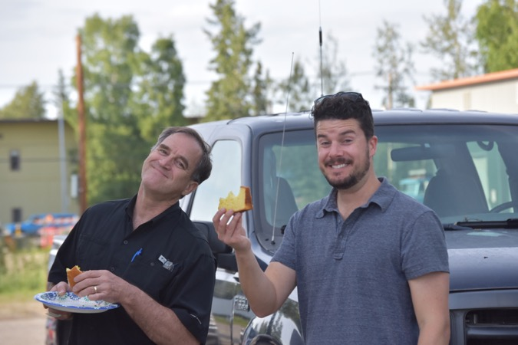
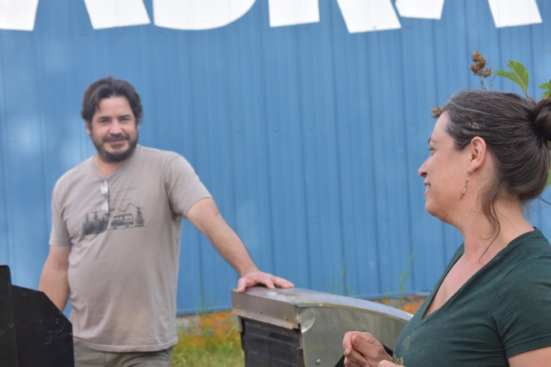
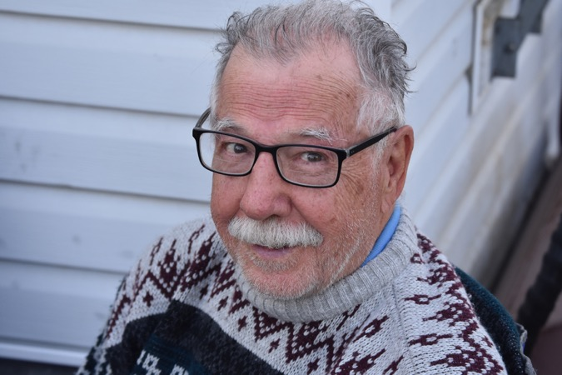
Canada Day BBQ

Slide 7
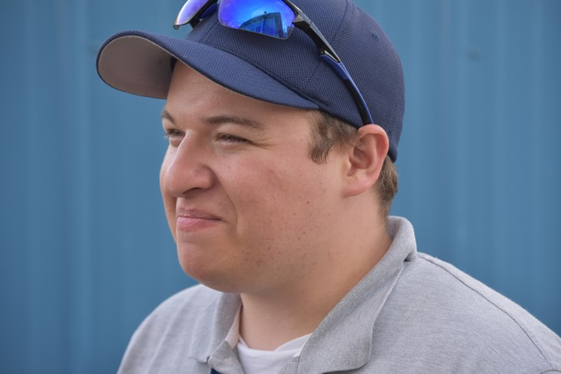

Slide 8
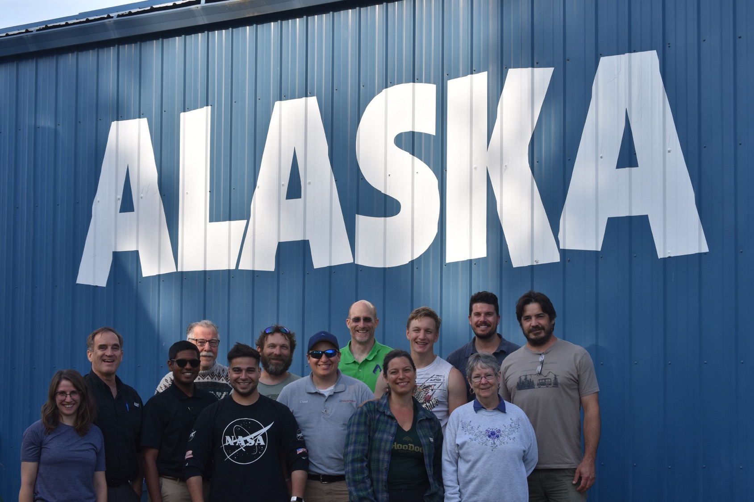

Slide 9
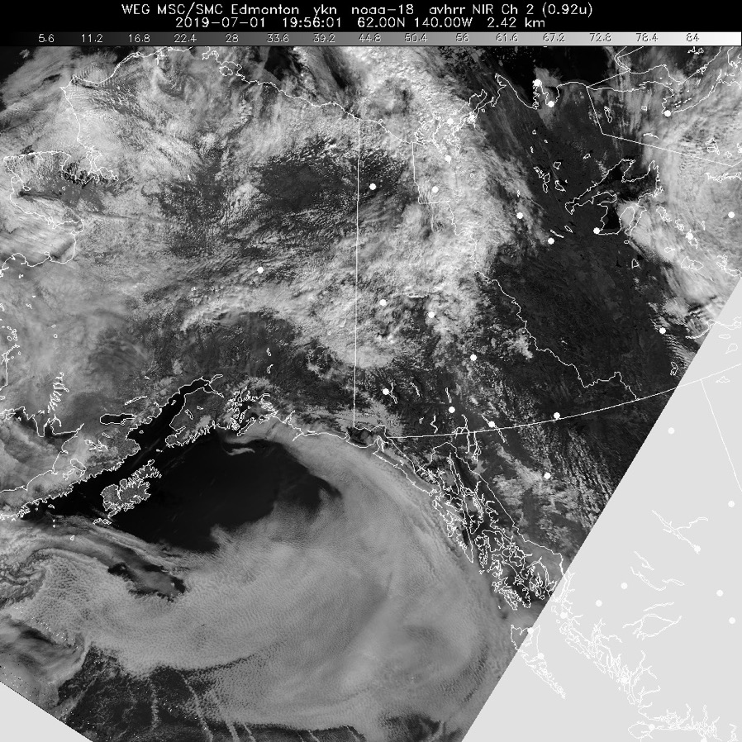
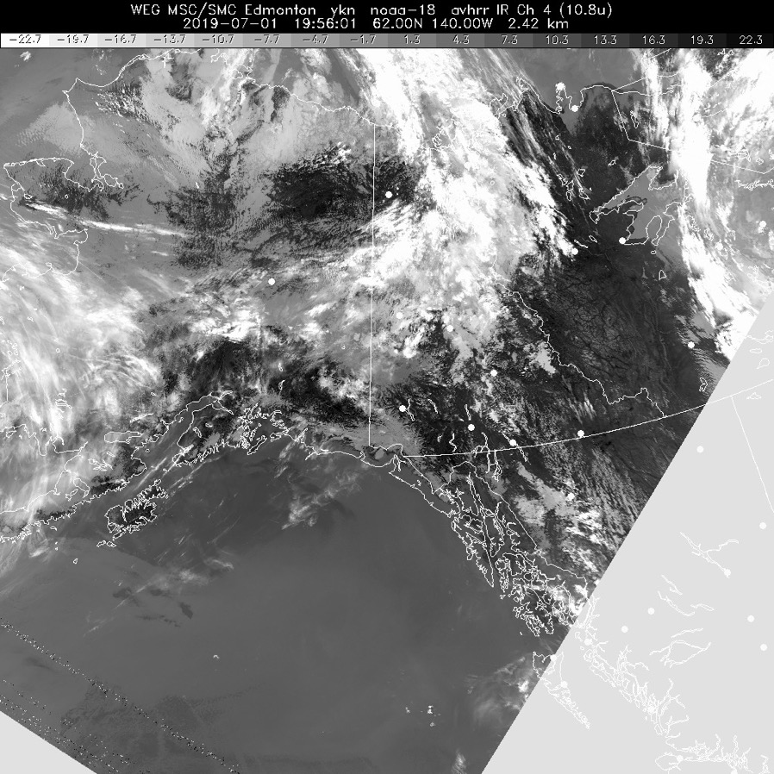
1 July 2019/DOY 182 Bellingham WA - Fairbanks Transit; Kluane Lake YT
POES Vis 1956Z
POES IR 1956Z

Slide 10
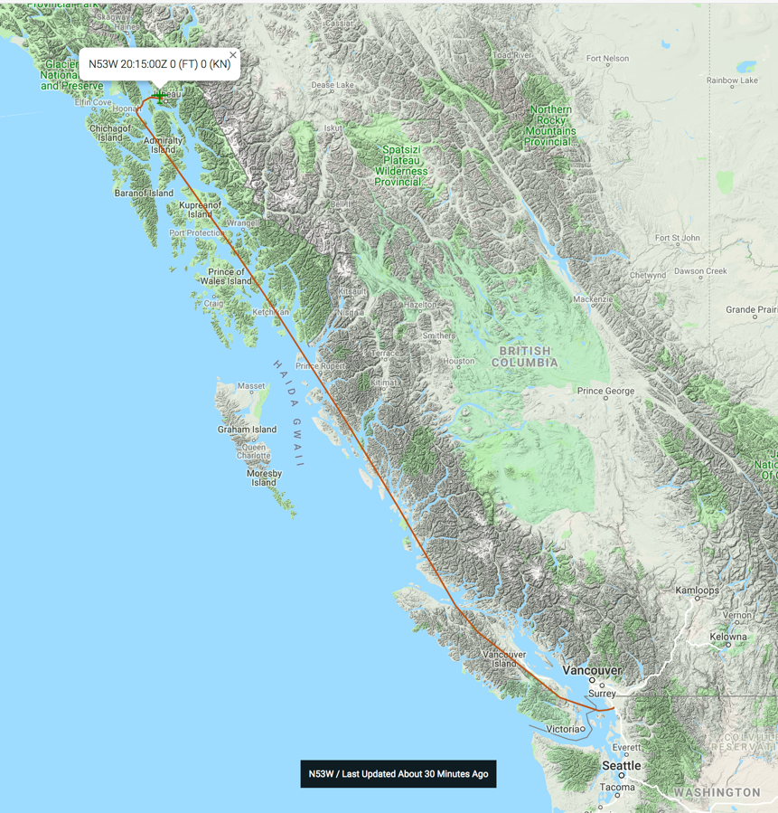
1 July 2019/DOY 182 Bellingham WA - Fairbanks Transit; Kluane Lake YT
Leg 1: Transit
Bellingham - Juneau
Leg 2: Juneau –
Kluane Lake – Fairbanks

Slide 11
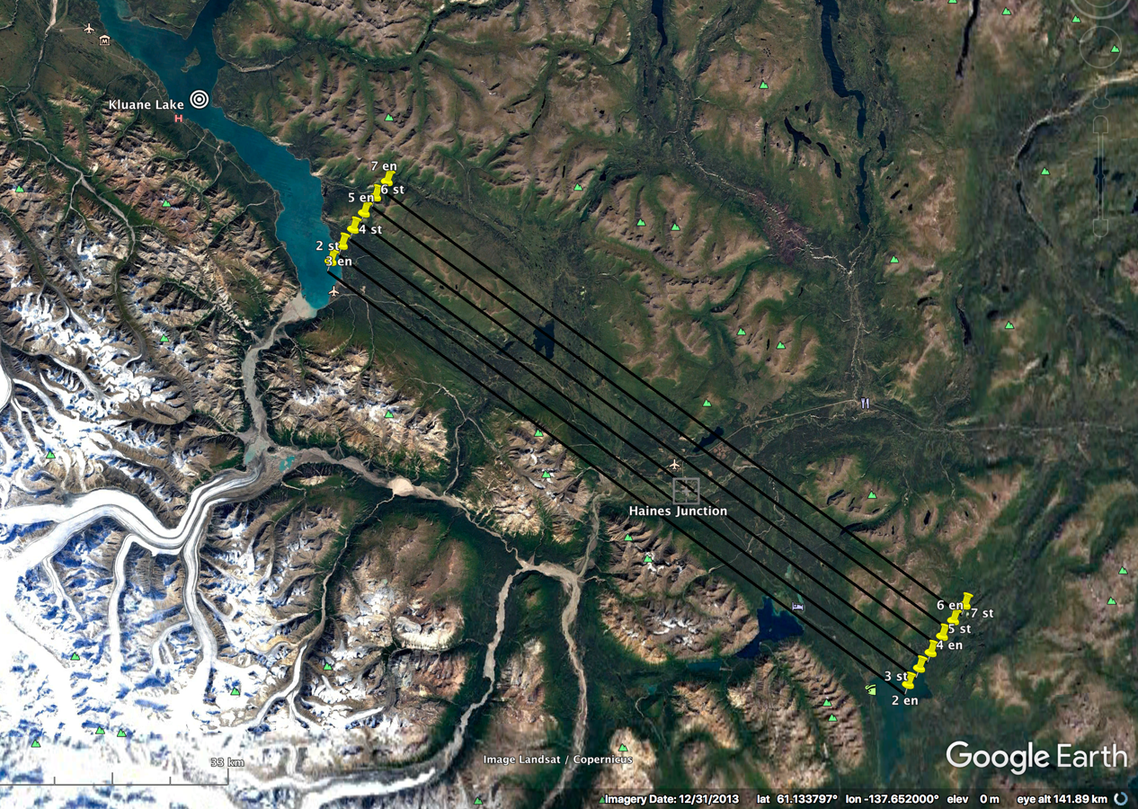
1 July 2019/DOY 182 Bellingham WA - Fairbanks Transit; Kluane Lake YT
Kluane Lake Area
Planned Lines

Slide 12
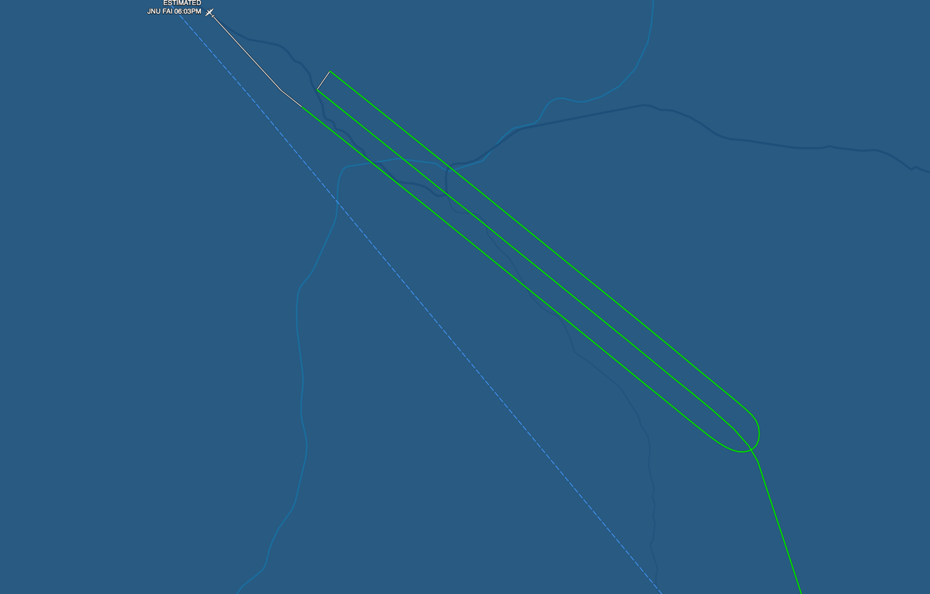
1 July 2019/DOY 182 Bellingham WA - Fairbanks Transit; Kluane Lake YT
Kluane Lake
Actual Lines

Slide 13
1 July 2019/DOY 182 Bellingham WA - Fairbanks Transit; Kluane Lake YT
AVIRIS-NG Quick-look products
https://avirisng.jpl.nasa.gov/cgi/flights.cgi?step=view_flightlog&flight_id=ang20190701t
A. Line KluaneLak_L003_FL206 ang20190701t220528_geo : Kluane Lake – Haines Junction grid
B. Line KluaneLak_L004_FL206 , ang20190701t222447_geo: Kluane Lake – Haines Junction grid
A
B
A. A few clouds near Kluane Lake
B. Significant cloud cover
Notes:
7/19/19: Error in initial processing log file names – all are given L005 – which cant be right.
Flight log gives acquisitions as
Start Site Name TrackAir
2205 KluaneLak_L003 4
2225 KluaneLak_L004 5
2240 KluaneLak_L002 3
2258 KluaneLak_L001 2
2314 KluaneLak_L005 6

Slide 14
1 July 2019/DOY 182 Bellingham WA - Fairbanks Transit; Kluane Lake YT
AVIRIS-NG Quick-look products
https://avirisng.jpl.nasa.gov/cgi/flights.cgi?step=view_flightlog&flight_id=ang20190701t
A. Line KluaneLak_L002_FL206 ang20190701t224021_geo : Kluane Lake – Haines Junction grid
B. Line KluaneLak_L001_FL206 , ang20190701t225819_geo : Kluane Lake – Haines Junction grid
A
B
A. A few clouds near Kluane Lake
B. A few clouds near Kluane Lake
Notes:
7/19/19: Error in initial processing log file names – all are given L005 – which cant be right.
Flight log gives acquisitions as
Start Site Name TrackAir
2205 KluaneLak_L003 4
2225 KluaneLak_L004 5
2240 KluaneLak_L002 3
2258 KluaneLak_L001 2
2314 KluaneLak_L005 6

Slide 15
1 July 2019/DOY 182 Bellingham WA - Fairbanks Transit; Kluane Lake YT
AVIRIS-NG Quick-look products
https://avirisng.jpl.nasa.gov/cgi/flights.cgi?step=view_flightlog&flight_id=ang20190701t
A. Line KluaneLak_L005_FL206 , ang20190701t231418_geo : Kluane Lake – Haines Junction grid
A
B
KluaneLak_L006_FL206 not attempted
A. RED – early abort - Clouds dominate
Notes:
7/19/19: Error in initial processing log file names – all are given L005 – which cant be right.
Flight log gives acquisitions as
Start Site Name TrackAir
2205 KluaneLak_L003 4
2225 KluaneLak_L004 5
2240 KluaneLak_L002 3
2258 KluaneLak_L001 2
2314 KluaneLak_L005 6

Slide 16
Backup

Slide 17
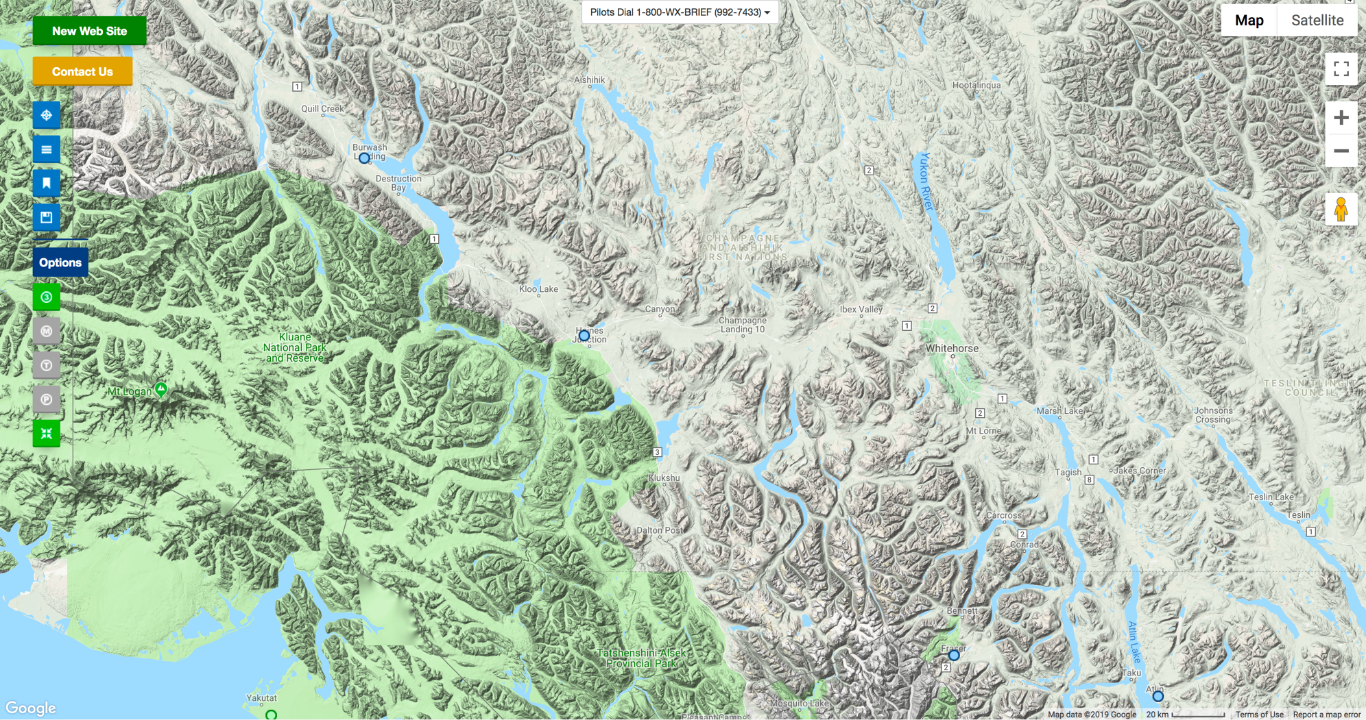
FAA Camera Locations

Slide 18
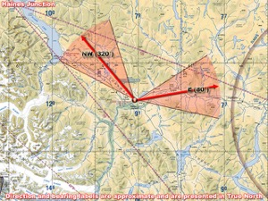
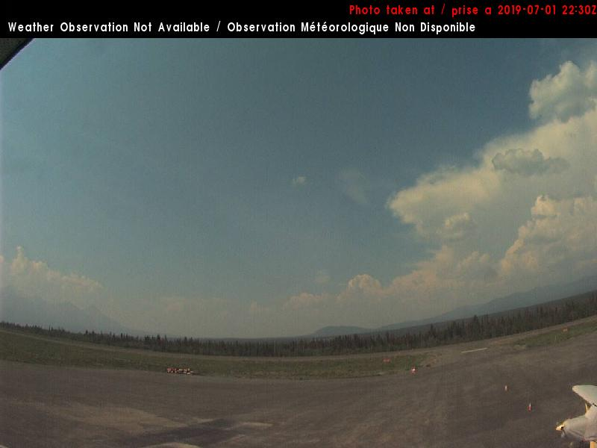
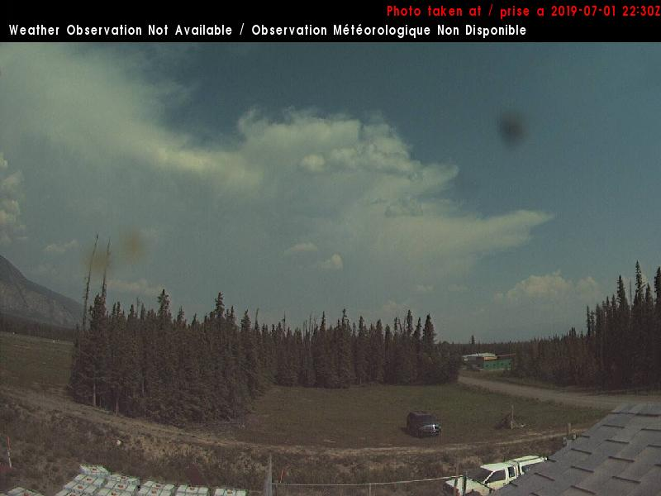
1 July 2019/DOY 182 Bellingham WA - Fairbanks Transit; Kluane Lake YT
Haines Junction YT – 1440 AKDT/2240 UTC
Northwest
East

Slide 19
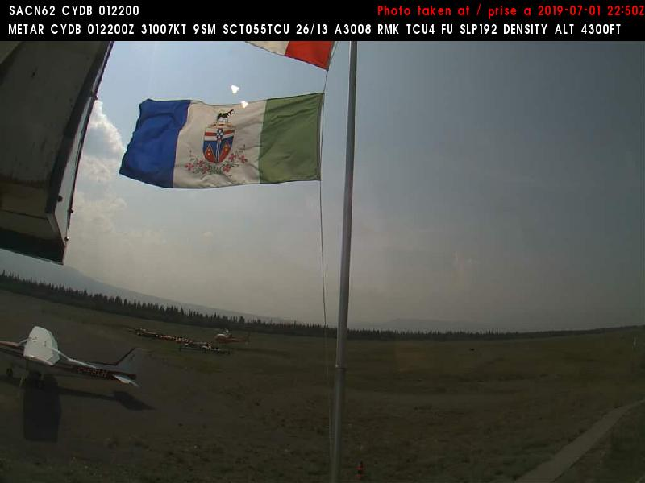
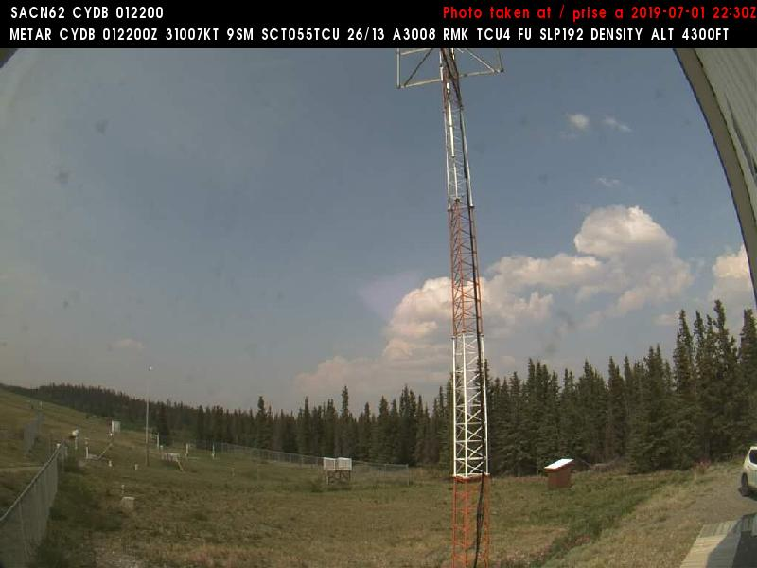
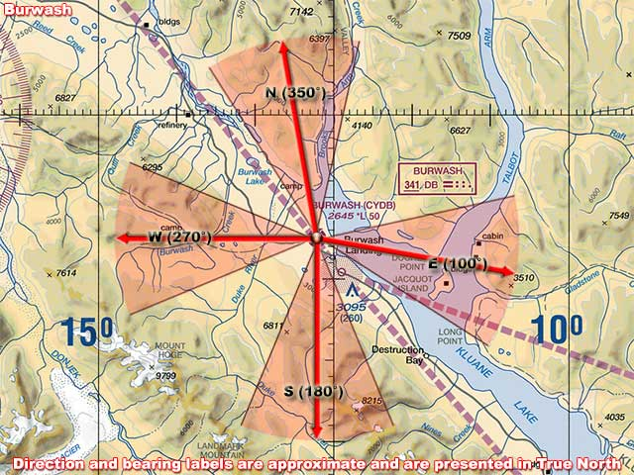
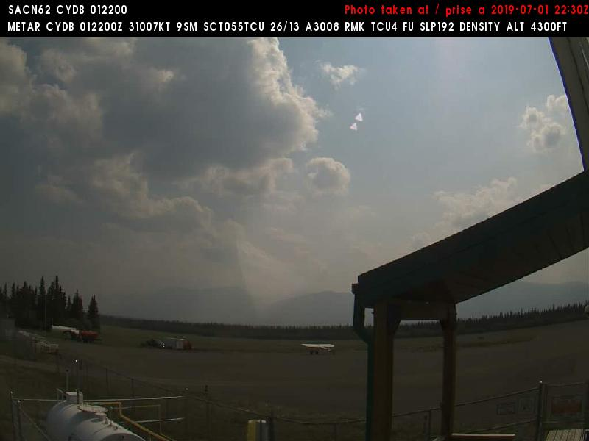
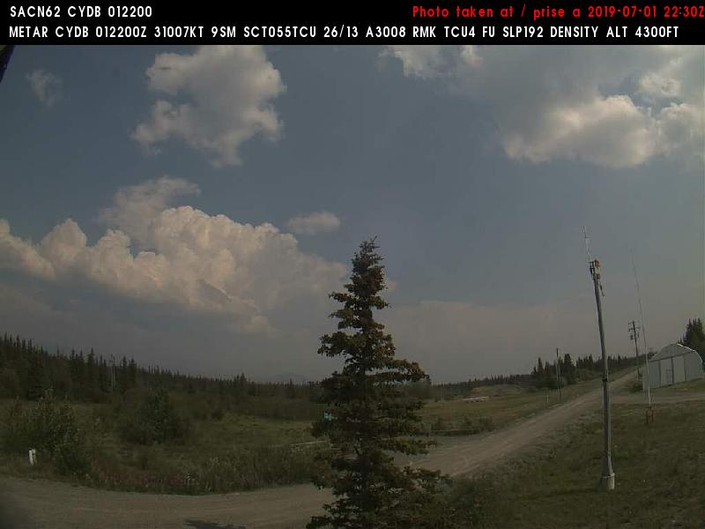
1 July 2019/DOY 182 Bellingham WA - Fairbanks Transit; Kluane Lake YT
Burwash YT – 1310 AKDT/2110 UTC

